Slide 1


UPPER YEARS BBABIR LLBBIR

Slide 2
4th Year Options – 1st semester
Curricular Internship
Great entry point to the Professional Sector
Exchange
The best way to gain exposure to another country while you discover a different University
Electives at IEU
An excellent way to personalize your professional profile

Slide 3
INTERNSHIP
Maximum 30 ECTS – elective credits only
Maximum of 2 separate Curricular Internships
1st semester of 4th year
Summer between 3rd and 4th year
Summer between 4th and 5th year
Valid NIE/DNI
ieustudentservices@ie.edu they will assist you with your NIE process.
Internship Approval - Needs to be at least one month duration and we must receive the initial application form at least TWO WEEKS before the start date. THIS IS NOT NEGOTIABLE!!
Evaluation – You will be required to complete evaluation forms during your Internship. Along with the company reports you will be awarded a grade which counts towards your GPA.

Slide 4
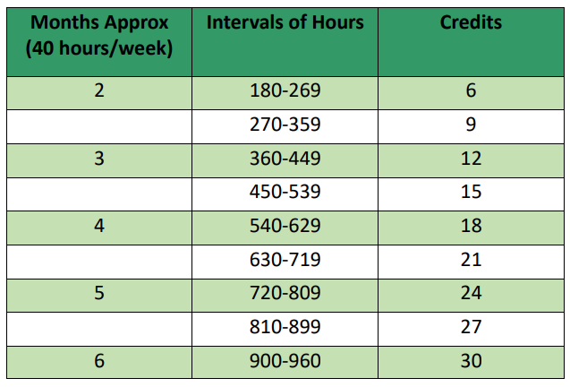
IE University Internship Allocation of Credits
For more Information about Internships: https://www.ie.edu/student-guide/bir-sep-2023/program/internships/

Slide 5
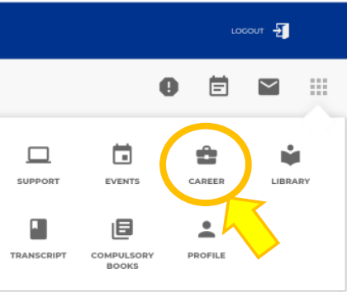
Talent & Careers
BIE Office
Contact IEU.Careers@ie.edu
Help with preparing your CV
Internship search
Book a meeting with them on 15th floor
Communication with Company
Career Portal -
Contact bir.biemadrid@ie.edu
Allocation of credits
Help with completing the application form
Evaluation Reports
Communication with student

Slide 6


4th Year
First Semester
When is the exchange?
ACADEMIC EXCHANGE ADVISORS:
BBABIR - eliaras@faculty.ie.edu
LLBBIR - nwiesehomeier@faculty.ie.edu
ADMINISTRATIVE ADVICE:
bir.biemadrid@ie.edu
International.Mobility@ie.edu

Slide 7

MARCH-APRIL
TIMELINE
MAY-JUNE
AUGUST-SEPTEMBER
OCTOBER
> Start to choose your courses
> Contact your Exchange Advisor
> Upload your courses, syllabi and credits on the International Mobility Platform
> Ensure your courses are approved
> Any rejected courses must be replaced
> You can make last changes via the International Mobility Platform
> Keep in contact with your Exchange Advisor to authorise any changes
NO CHANGES ALLOWED

Slide 8

CREDITS & GRADING
THINGS TO REMEMBER:
Many Universities follow a different grading structure to others, despite being in the same country
Some Universities do not use ECTS, so check the value of each course to ensure you are fulfilling 30 ECTS from IEU
Please check the following document located on Blackboard:
> International Mobility > Outgoing

Slide 9

CREDIT REQUIREMENTS
MANDATORY COURSES
- Must correspond to the IEU course syllabi
- No deviation from the study plan
Attempt: 30 ECTS
Min: 24 ECTS
If you take less credits you will need to complete these credits when you return to IEU
ELECTIVE COURSES
- More flexibility
- All courses must be academic
All approved and completed courses taken on exchange will appear on your IE transcript (PASSED and FAILED, WITH A GRADE)

Slide 10

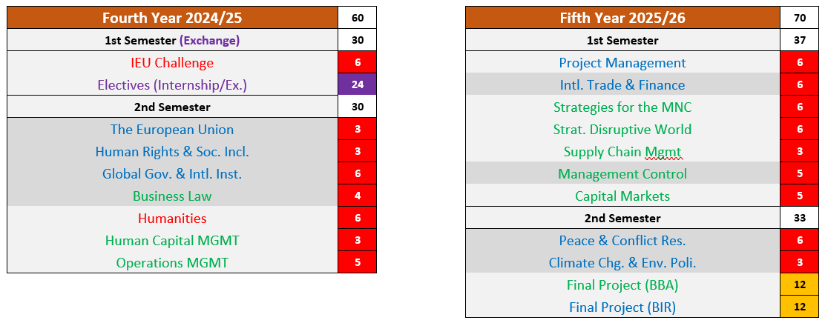
4th and 5th year BBABIR STUDY PLAN

Slide 11
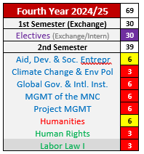
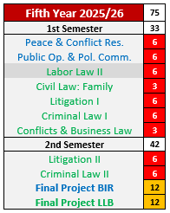
4th and 5th year LLBBIR STUDY PLAN

Slide 12

COURSES NOT APPROVED
Clínica de tenis (Tennis lessons)
Fundamentals of Acting
Football
Welcome Programme

Slide 13

CANCEL AFTER ACCEPTING
Please be aware
If you accept your spot at your chosen Exchange University and later cancel your exchange semester, you will not be eligible to complete an Internship.

Slide 14


RETURNING FROM EXCHANGE
Your Exchange transcript can take months to arrive, so please reach out to the BIR Office ASAP if you need to be enrolled in any courses you were unable to take on exchange.
The validation of credits can take up to 6 weeks from receiving your transcript.
For more Information about Exchange: https://www.ie.edu/student-guide/bir-sep-2023/program/exchange/

Slide 15
ELECTIVES at IEU
Bidding for Electives
In July you will be enrolled in an elective placeholder block of 30 ECTS LLBBIR / 24 ECTS BBABIR in anticipation of your elective semester.
Once the bidding platform opens in July 2024 you can bid on your choice of preferred courses.
Have a look at the electives we have available in 23-24 here: https://www.ie.edu/student-guide/bir-sep-2023/program/electives/
Subject to change next academic year.

Slide 16

CONTACT THE BIR OFFICE
bir.biemadrid@ie.edu
FERNANDO GOMEZ
Program Assistant

Slide 17

THANK YOU!

